Slide 1
Radar Status Overview 2011
Mark Lester
With thanks to the SuperDARN PIs

Slide 2
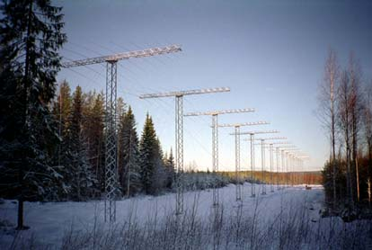
CUTLASS Radars – General Operation
In general no major operational problems
Radars continue to run in good health
Some comms issues but nothing that is insurmountable
No major developments on the radar due to lack of funding

Slide 3
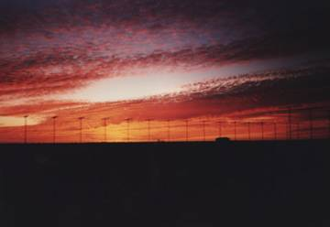
CUTLASS Future Funding
Since the last meeting we had one proposal unfunded last year and submitted to further proposals which have been/are being considered
One of these two proposals, to the NERC Arctic Programme, was unfunded
Other grant, to the NERC Responsive Mode call, is still being considered and we will know the outcome in July 2011
Currently operations (site rental, telecoms, electricity) are funded through group resources
Hermann Opgenoorth has also submitted a proposal to Swedish research council for support as part of a grant to exploit Swarm data after launch in 2012

Slide 4
2010-2011
Kodiak and McMurdo Status

Slide 5
Kodiak (mostly) worked again this year
No major changes this year
Minor problem in ROS was causing occasional hanging of the OS. Latest version of OS seems to have solved this problem.
  Day gap: 20100507 20100509 2
  Day gap: 20100608 20100613 5
  Day gap: 20100918 20100920 2
  Day gap: 20101127 20101210 13
  Day gap: 20110113 20110115 2
  Day gap: 20110119 20110127 8
  Day gap: 20110212 20110214 2
  Day gap: 20110219 20110222 3

Slide 6
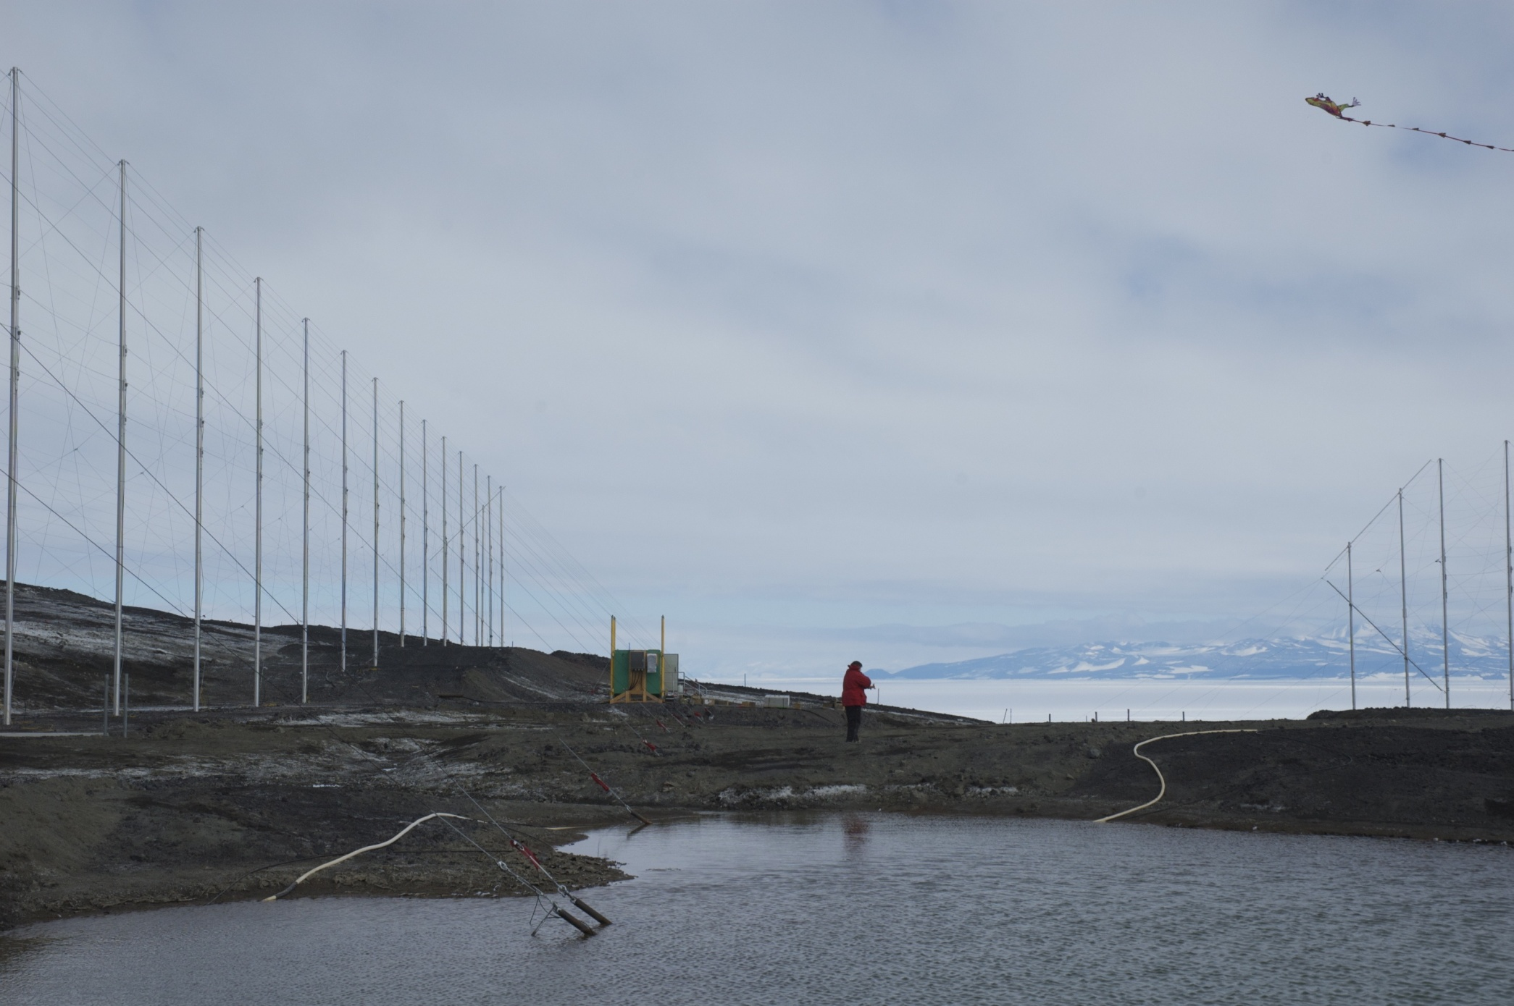
McMurdo
No major changes
No significant problems

Slide 7
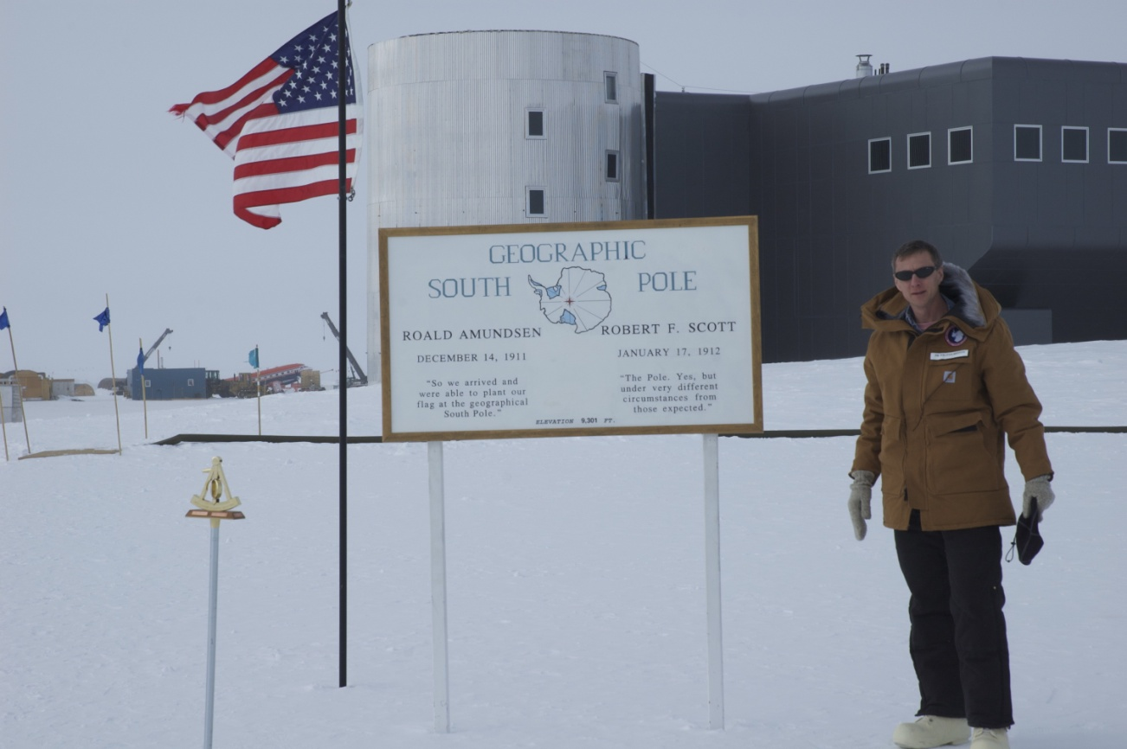
Proposal Accepted
Radar for South Pole Station funded
Slated for construction Dec 2011-Jan 2012

Slide 8

King Salmon Radar status
-2010-2011 -
National Institute of Information and Communications Technology
2010/06 7 transmitters are either faulty or non functioning.
2010/11/26 QNX 4 PC (for ‘agc_commander’, not using radar operation now) cannot be accessed from remote site.
2011/02/24-27 Tsutomu Nagatsuma, Kaori Sakaguchi and Jeff Spaleta visited King Salmon radar site. Jeff successfully introduced new radar operating system with new PCs. We found that 1 antenna cable was disconnected and 3 antennas showed abnormal VSR.
2011/03/08 KSR controlling PCs cannot be accessed from remote site. It might be caused by problem of UPS.
Currently, KS radar stopped operating. Jeff will visit KS to replace UPS in June for restarting the system. Other problems will be solved in this summer.

Slide 9

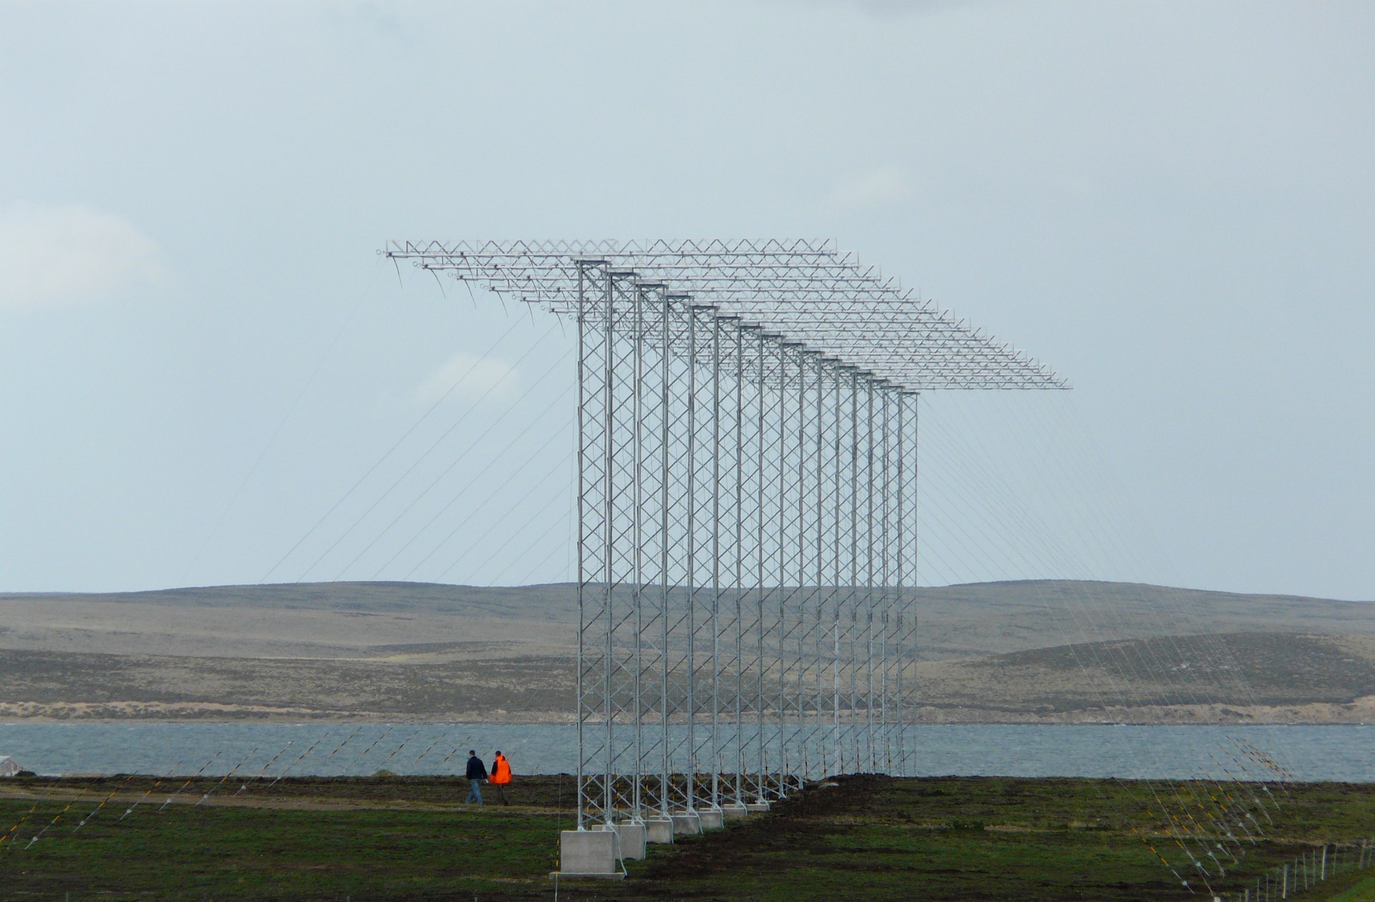

Falklands/Halley radar summary
Mervyn Freeman
Steve Milan

Slide 10
Falklands summary
Halley radar currently in the Falklands (with U. Leicester masts)
Operating less than 100% of time (variable power interruptions), mostly at 12 MHz
Lots of mesosphere and sea scatter. Little ionospheric scatter (although unclear how to separate it from sea scatter)
Initial papers submitted or in preparation on
  mesosphere wind climatology (Hibbins et al.)
  mesosphere turbulence (Chisham)
  sub-auroral ion drift event (Grocott et al.)
  sea scatter undulations/atmosheric gravity waves (Milan et al.)
Radar will cease operation in September 2011 for shipping to Halley.
Replacement options under consideration.

Slide 11
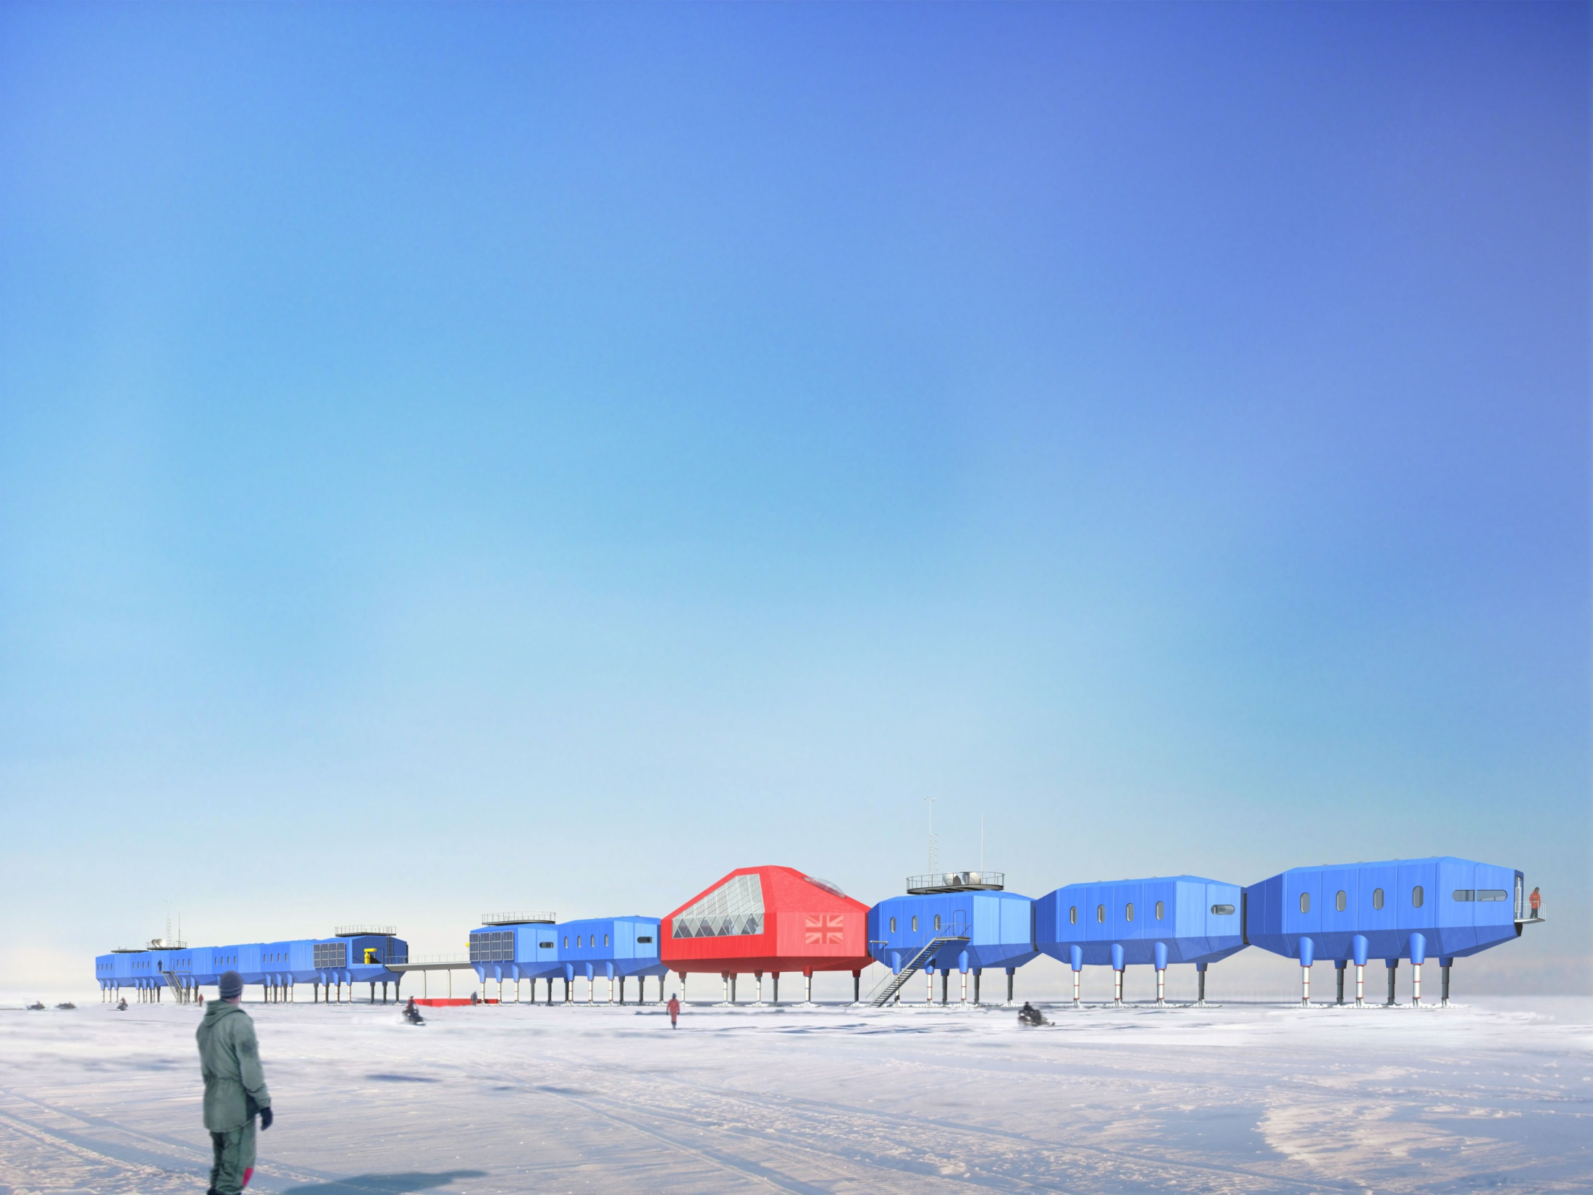
Halley summary
New Halley 6 base on schedule for completion in Feb 2012.
Radar to be shipped from Falklands end Jan 2012 to resume operations in Feb 2012.
Very tight timetable makes it high risk, but it is a high priority for BAS.

Slide 12
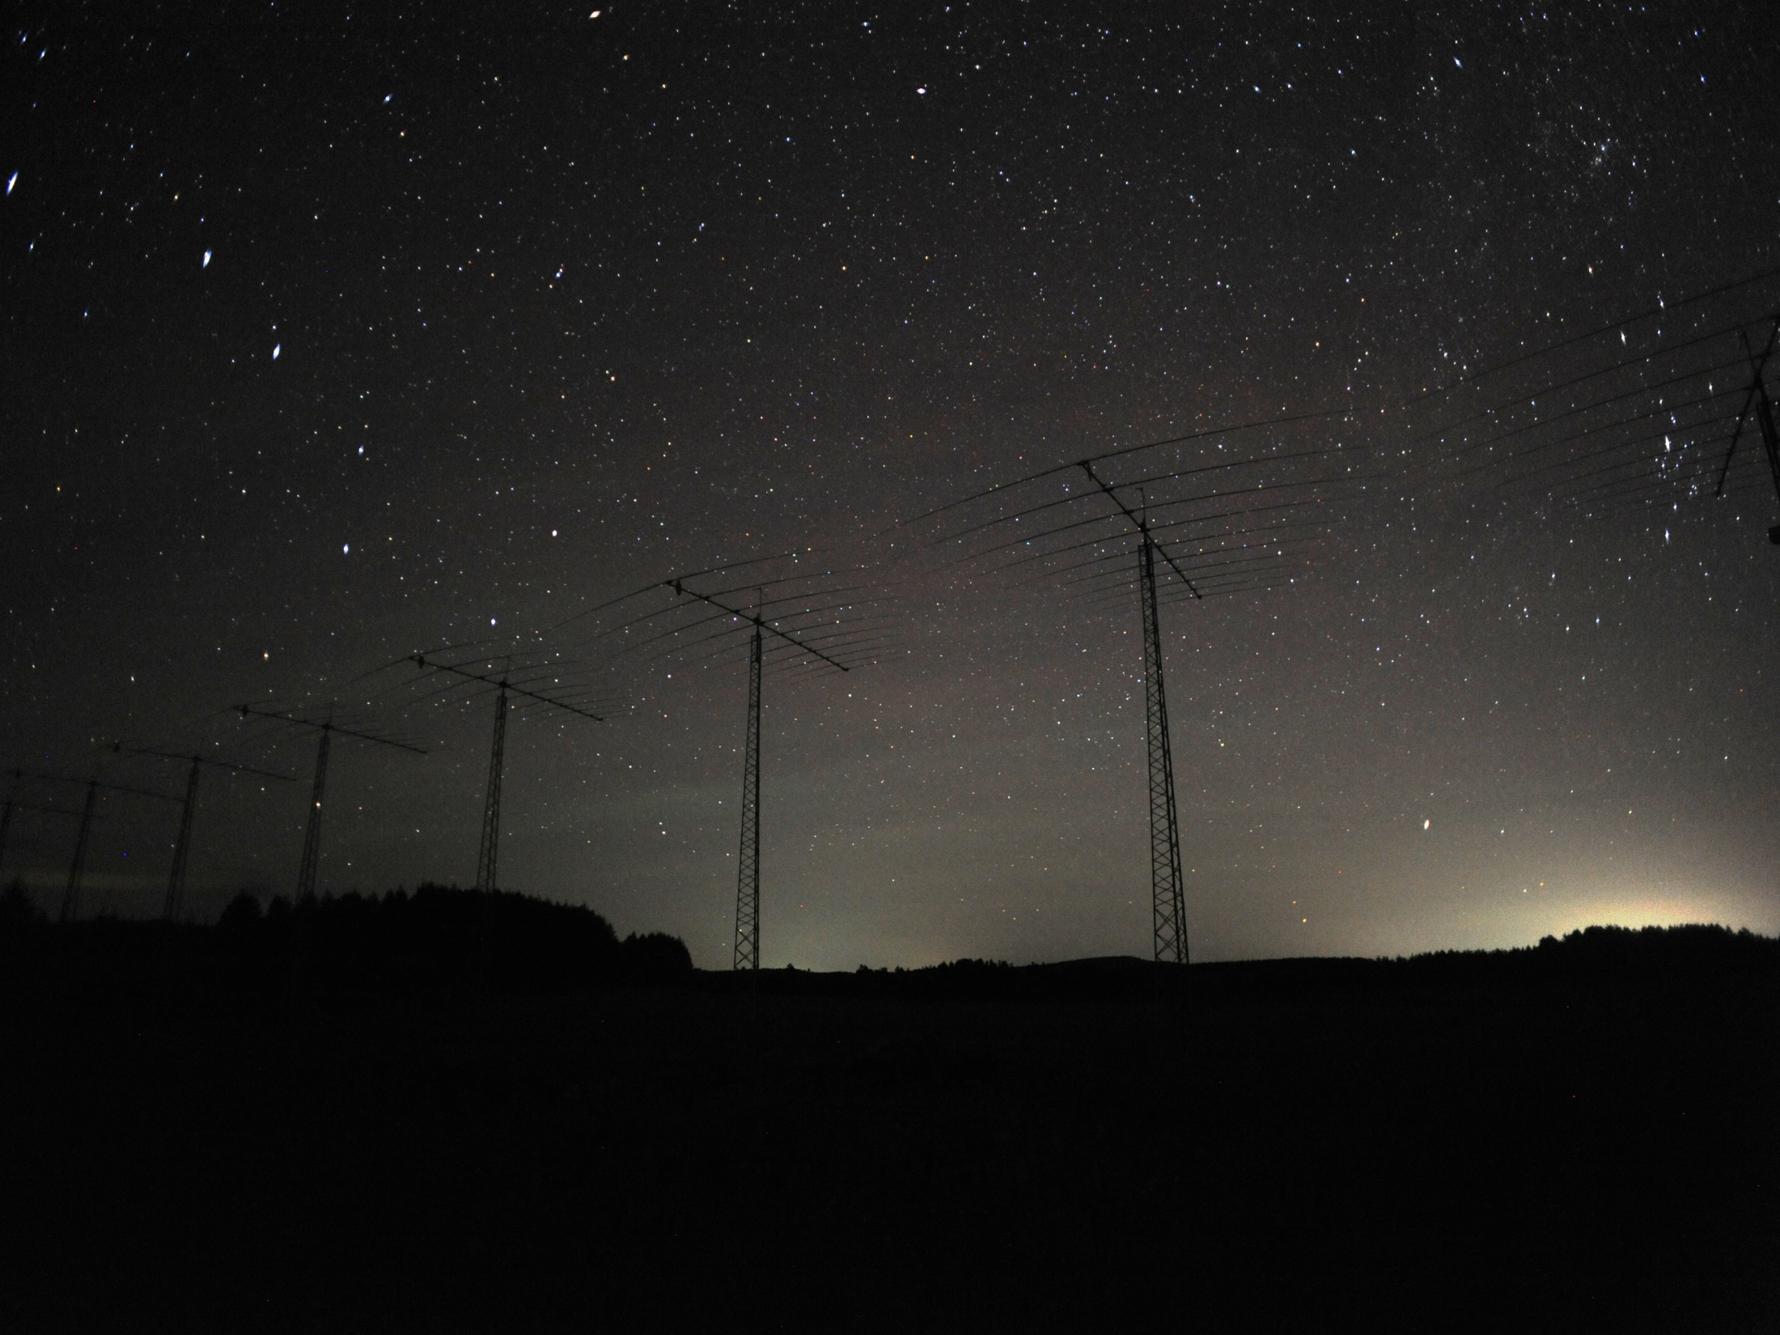
Hokkaido radar status report
Operated normally for most of the time.
BASBOX stopped working owing to CP board overheating (room temp was ~30 C) on Mar 20. The radar was stopped until the box was replaced by a spare unit on Mar 22.
Access to the radar site (in the midst of cowfields) was highly restricted during 2010 summer because of the protection against the foot-and-mouth disease in Japan (fortunately that did not affect the radar operation).
Started monitoring the northern sky continuously using digital camera since Jun 11, 2010, for detecting gravity waves (see the background picture), NLCs and low-latitude auroras.
Planning to begin storing TMS mode data this year.
Notes:
12

Slide 13
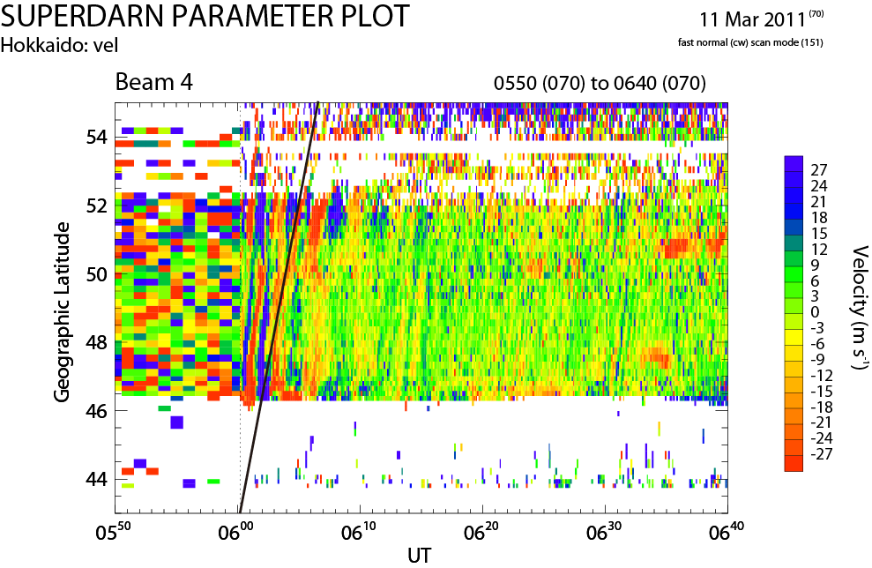
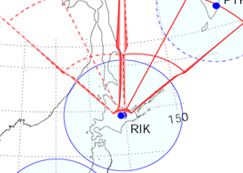
Hokkaido radar status report (cont.)
Regarding the earthquake
Fortunately the radar was not damaged by the big earthquake in Japan on Mar 11, although it observed very interesting ionospheric disturbances possibly caused by the earth’s surface (Rayleigh) waves converted to upward propagating acoustic waves.
The data (vel of ground-scatter echoes) show the upward-downward motion of the ionosphere with velocities of up to 100 m/s, meaning that the ionosphere was moving with this speed (not the ground!)
Nishitani et al., submitted to EPS
Hokkaido west radar
We are struggling hard continuously to get funded for the new radar.
Notes:
13

Slide 14
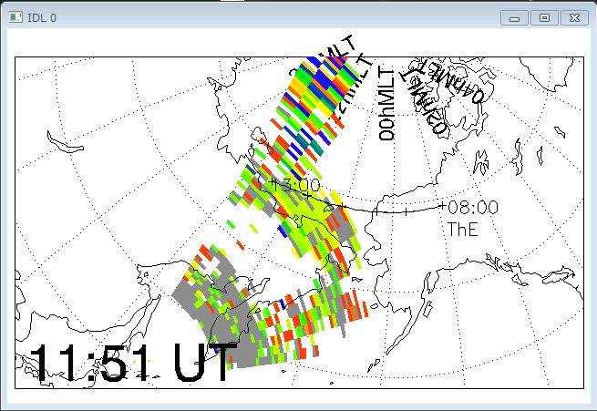
Fitacf CDF files prepared for data analysis on TDAS by ERG-SC
ERG-Science Center (ERG-SC), in collaboration with Japanese SD PI groups, has been working on archiving their fitacf data as Common Data Format (CDF) files.
The CDF files are going to be available to the science community for use in TDAS (THEMIS Science Data Analysis Software) which has been selected as a primary data analysis software for the ERG project.
For details, please check the poster by Hori et al.
and the talk by Miyoshi et al. for the ERG project!
Visualization by ERG-SC plug-in for TDAS
IDL> timespan, ‘2008-04-03’
IDL> erg_load_sdfit, site=‘hok’
IDL> sd_time, 1151
IDL> plot_polar_sdfit, ‘sd_hok_vlos_bothscat_1’
; Load HOK data for 3 Apr 2008 and
; make a fan plot on the world map
;Load THEMIS orbit data and draw footprints
IDL> overlay_map_themis_ifoot, $
'20080403',['e','0800','1300']

Slide 15
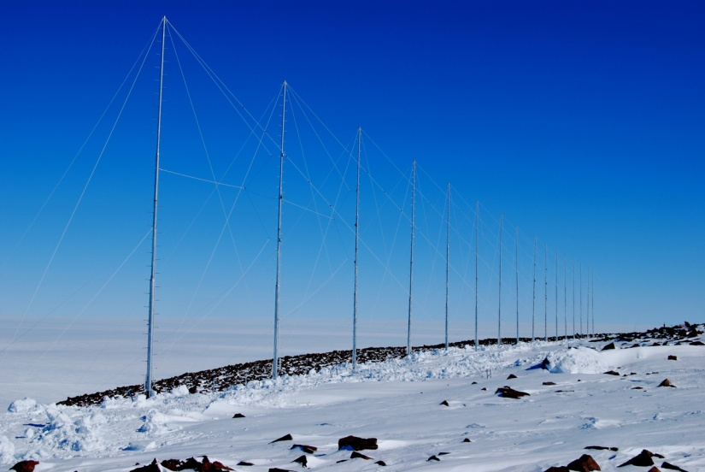


Sanae Radar
Radar Operations:
Radar operated on full array
of 16 folded dipole antennas
from February 2010
Gain up to standard, good scatter (gain was slightly compromised with 14
antennas in 2009)
Minimal down time; maintenance 12-31 Jan. 2011
Data sent overnight to Durban, onward transmission to APL.
2010 data included in SD data distribution.
Notes:
We reported last year that 14 'new design' folded dipole antennas had been installed at Sanae in 2009 following the destruction of the old Sabre antennas, and that the last 2 new antennas were installed last February during the Antarctic 'takeover' period. So the Sanae radar has now been running on its full complement of antennas for more than a year. With 14 antennas, the gain was slightly down in 2009, but the gain is now back up where it should be. The result has been improved scatter.
The radar operated reliably through the year, with minmal downtime. However, it was off for an extended maintenance period during the Antarctic summer 'takeover' period during the last 3 weeks of January this year.
Each 24 hours' data is now routinely ftp'd the following night via satellite link to a server in Durban, from where it is sent on to APL. This system has been quite reliable, and has meant that the 2010 Sanae radar data could be included in the SD data distribution. (One no longer has to wait for an annual shipment of data from the Antarctic.)

Slide 16

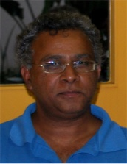
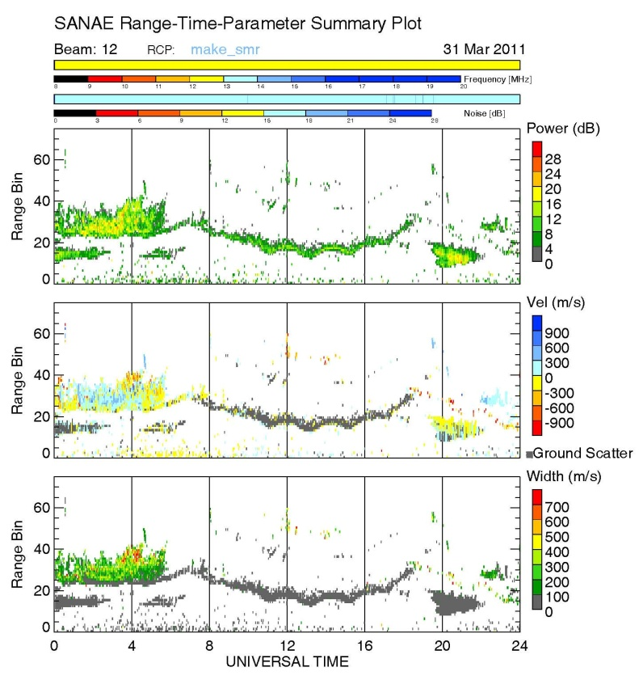

Sanae Radar
Changes:
Judy Stephenson
Erhard Mravlag resigned in September 2010
Judy Stephenson took over as Data Manager
Lindsay Magnus resigned from his post at HMO in March 2011, quit as PI
Jon Rash returns as PI
New Technology Manager at HMO is Kessie Govender (ex UKZN); includes management of Sanae radar operations
Hermanus Magnetic Observatory (HMO) now SANSA Space Science, ‘research arm’ of SANSA
[SANSA = South African National Space Agency, established 2009, CEO Sandile Malinga]
Changes in funding SA Space Science research, and in Antarctic funding (may be for better)
Kessie Govender
Notes:
There have been a number of significant changes in operations and personnel in the South African SuperDARN operation.
Erhard Mravlag resigned in September 2010 and emigrated to the UK.
Judy Stephenson took over Erhard's position as Data Manager, while continuing her role of researcher.
Lindsay Magnus resigned from his post as Technology Manager at HMO at the end of March this year, lured by a job in Cape Town with the SKA. As a result he could not continue as SuperDARN PI.
Lindsay's replacement at HMO is Dr Kessie Govender, a former UKZN lecturer, who is attending this SuperDARN Workshop as part of his 'steep learning curve' for managing the operation of the Sanae radar. The radar will continue to be a priority for HMO.
Jon Rash has resumed the position of PI for the present. He apologises for his absence from this meeting.
The South African National Space Agency, SANSA, was established in 2009. Dr Sandile Malinga, known to many in the SuperDARN community, was acting CEO, and was confirmed in the position at the beginning of this year.
The HMO has been transferred to SANSA and is now known as SANSA Space Science; itwill be the 'research arm' of SANSA.
It remains in Hermanus and the Magnetic Observatory function continues.
There are also planned changes in the way Space Science and Antarctic Research are funded, we hope changes for the better.

Slide 17


SuperDARN 2011 Radar Status:
Virginia Tech
Goose Bay
Kapuskasing
Blackstone

Slide 18
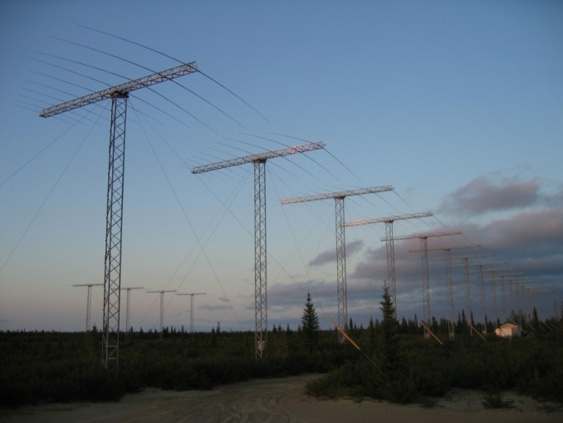
Goose Bay:
2010-2011
  No significant operational issues
  Some outage time in August and February due to power and internet connectivity issues
  The AFWA sounder has been decommisioned and packed out
  We are now alone in occupying the site and have some increased costs.

Slide 19
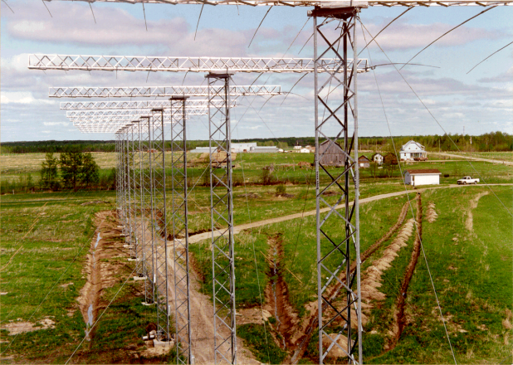
Kapuskasing: 2010-2011
  Nearly continuous operation
  Some software issues remain
  An upgrade to the internet connection is planned
  Outdoor maintenance due at both Goose and Kap (roads, antennas)

Slide 20
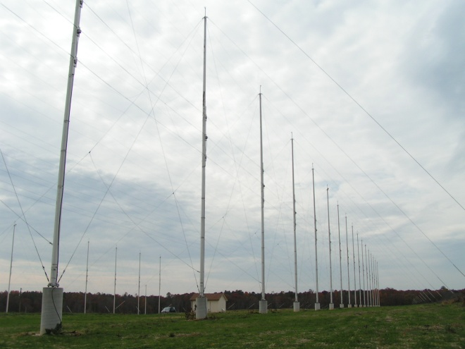
Blackstone:
2010-2011
  Continuous operation
  Still bothered by intermittency of the internet connection
  Leicester is planning to move out its electronics in July
  A package of replacement electronics is being assembled at VT
  Hopefully, the interruption to operations will be brief

Slide 21

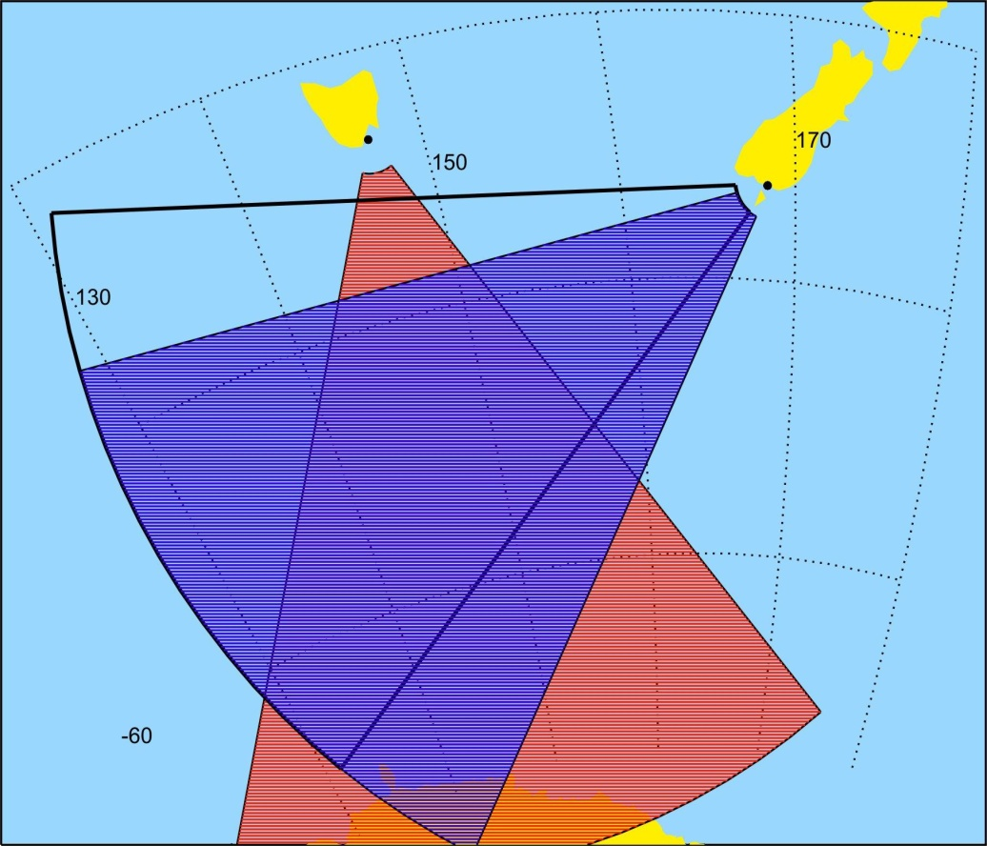
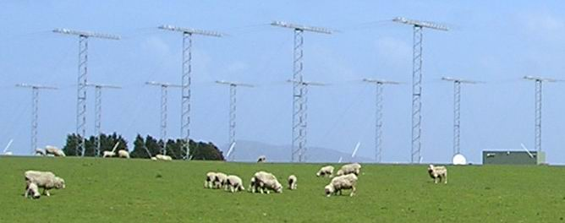
TIGER Status Report
(Tasman International Geospace Environment Radar)
TIGER Operations 2010-11
Staff changes in 2010/2011
Bruny radar generally reliable
  Loss of data for 9 Dec. 2010 (22 UT) until 4 Jan 2011 (4 UT) - Co-ordination problem in detecting/fixing a fault
  Have new Main/Hardware Server PCs with the new Linux based ROS ready to deploy
Unwin radar had lower power and occurrence
  lightning strike in 2010 left some problems (eleven power supplies destroyed). These fixed by Feb 2011
Unwin Channel B
Unwin Channel A
Bruny
Bruny
Unwin

Slide 22
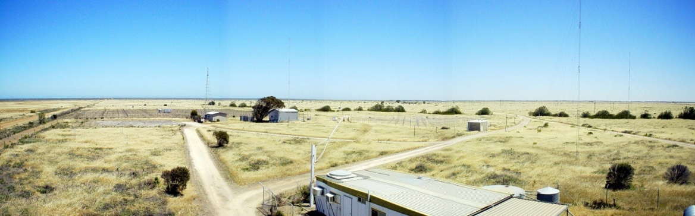
TIGER Status Report
(Tasman International Geospace Environment Radar)
TIGER 3 at Buckland Park
Funded by Australian Research Council infrastructure grant
Partners:
La Trobe University
University of Newcastle
University of Adelaide
Fully digital radar using new architecture with transceiver per antenna
Tests on bench with 5 transceivers
Field tests scheduled late June
Improved S/N from design
Inherent phase calibration
90+ degrees FoV, extended range (110 bins)
Revised Timeline:
Completion September 2011
Boresite: 140°E
Ground equipment possible in VIC, TAS, NZ
T3 revised FoV (Eddie’s Antennas)
Buckland Park

Slide 23
TIGER Status Report
(Tasman International Geospace Environment Radar)
Current Funding
Current Operational Funding:
Defense Science and Technology Organisation 2009-13
“Current” Research Funding (from Roman):
Australian Research Council Linkage Project (LTU + IPS) 2010-12
Ionospheric Prediction Service partner contribution to ARC Linkage Project 2010-12
Defense Science and Technology Organisation research contract with LTU 2010-2012
Future Funding Applications
Australian Research Council Discovery Scheme:
Application to be submitted in March 2012
Australian Research Council Large Equipment Infrastructure Fund (LEIF) Scheme:
Application to be submitted in March 2012 for TIGER 4 – Circular array to be located at Newcastle if costings can be met

Slide 24
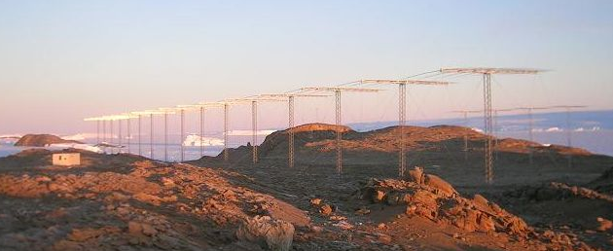

Status Report of
SENSU Syowa South and East radars
Natsuo Sato and Akira Sessai Yukimatu @ NIPR
SD Workshop 2011, Dartmouth College, Hanover, N.H., U.S.A., May 29 - June 4, 2011
Notes:
Status Report of SENSU Syowa Souoth and East radars...

Slide 25
SENSU Syowa South & East Status Report
Both SENSU Syowa South & East have not encountered too major problems. But S.South. shown poorer data compared with S.East. - not fully been solved yet.
Antenna maintenance: As reported last year, to reduce the antenna maintenance work at Syowa, the way to repair them has been changed so that we replace any parts by an improved version of the parts if any even if current one is not damaged.
More maintenance work for a shorter time scale, but the number of the antennas that needs to be repaired as well as the amount of maintenance work will decrease in a longer term...-> after one year, the repaired antenna had no problem at all!
Possibility to introduce new designed antenna will also be investigated if needed.
Imaging radar implementation: will hopefully happen in a few years after enough test at a real radar site like Finland under a great support by Leicester group before being brought down to Syowa.
PANSY MST/IS radar: (47 MHz, a big budget funded 2 years ago) installation and test operation has been started in last austral summer (1000 antenna & ~100Txs)
First light on late March made successfully with initial data.
Rayleigh/Raman Lidar & millimeter-wave spectroscopic radiometer
also installed successfully and started operation at Syowa
(LIDAR - 5-10~70-80km Temp. & atm. density, milli..radiometer – height profile of atm. minor constituents)
PMC/NLC echoes(@~85-86km) was detected by LIDAR system in Feb.
Comprehensive & coordinated observational research with SD, PANSY, MF radar, LIDAR, all sky imagers, photometers, magnetometers etc is about to be kicked-off.
Notes:
as written...
"PANSY" radar – First MST/IS radar in Antarctica (47MHz) – 2 years ago successfully got funded –> last year manufactured in Japan –>
last austral summer (the end of last year to early this year), about 1000 antenna were constructed very quickly and (only) 57 Transmitters were brought and installed.
First light in late March this year and initial data successfully obtained.
"Rayleigh/Raman Lidar" (for vertical measurements of Temperature and atmospheric density in 5-10 ~ 70-80km altitude range) and
"millimeter-wave spectroscopic radiometer" were also installed in the same austral summer (early this year).
Rayleigh/Raman Leidar successfully detected echoes from PMC/MLC @ 85-86km altitude in early Feb.

Slide 26
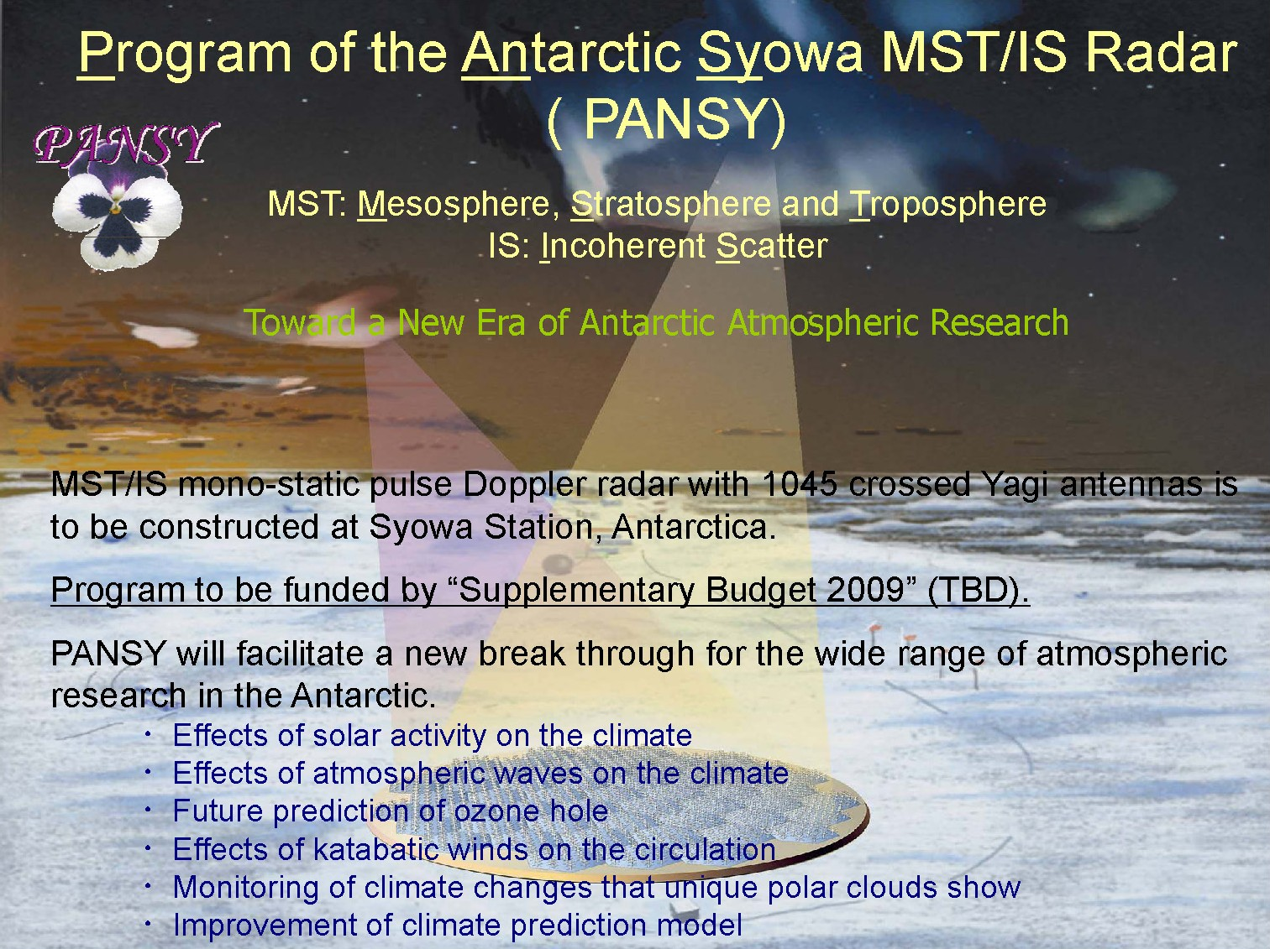
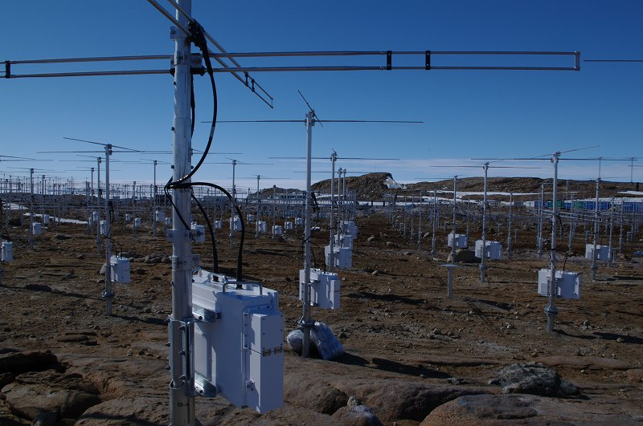
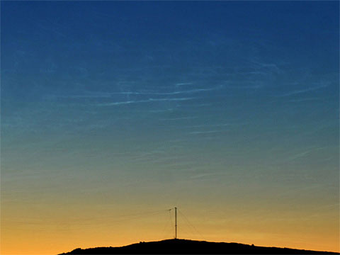
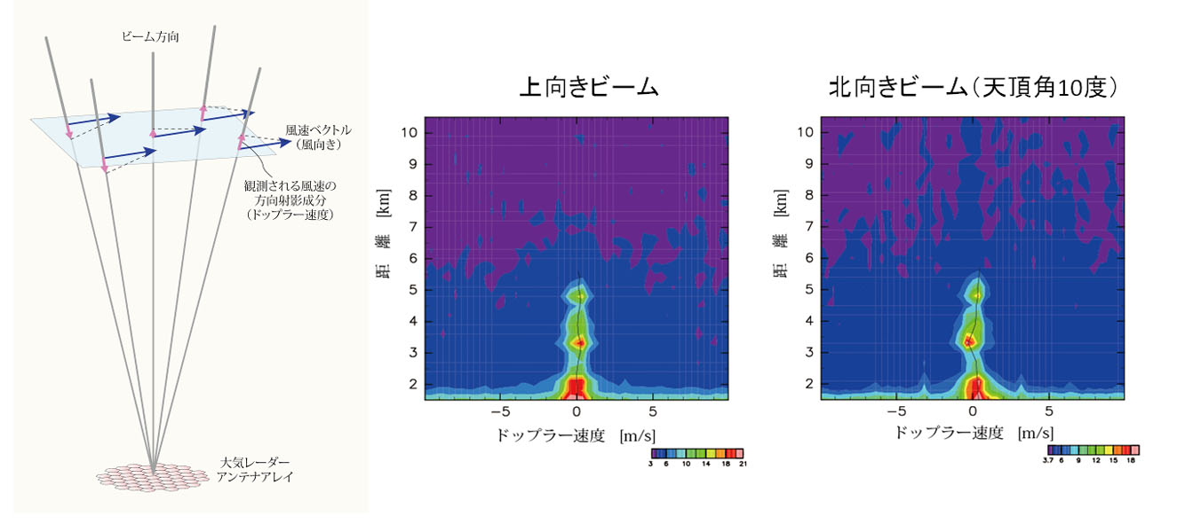
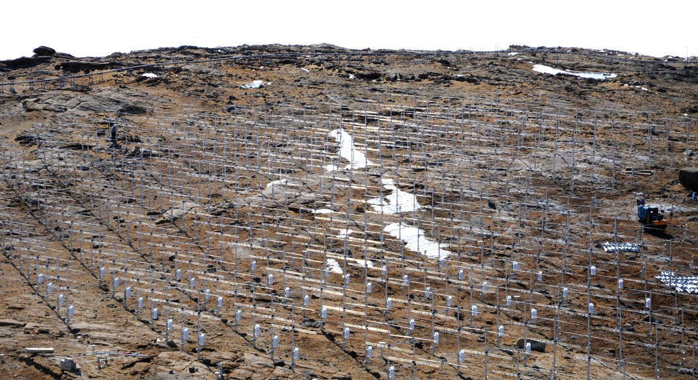
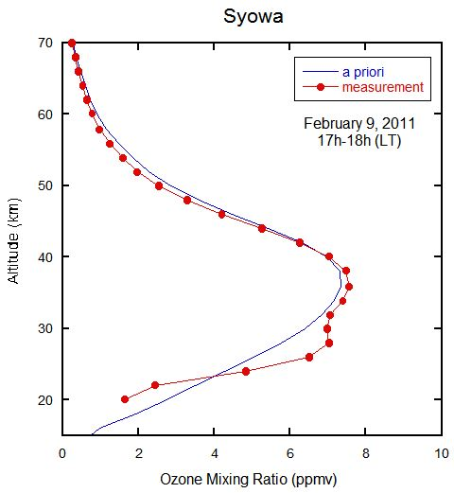
Syowa Rayleigh Lidar
PANSY
2009 PMC by eye & photo
2011
PMC by Syowa R/R LIDAR
3-D neutral wind velocity (inc. vertical comp.) obtainable
in 0-30km & 50~110km altitude range as MST Radar!!
Ne for 100-500km etc can be obtained as an IS radar!
PMC
PMC
upward beam
northward beam (Z=10deg)
~1000antenna & 57Txs installed – First light from 57Txs(5%, sensitivity 1/300)
Distance [km]
Distance [km]
20:09 20:39 21:10 21:41 22:11 22:42
UT
Ozone profile by
millimeter-wave radiometer
successfully got
20:00 – 21:30
21:30 – 23:00
Doppler vel
PMC
Doppler vel
First light in late March, 2011
Notes:
* The first one is the one shown last year about PANSY radar.
* First pop-up is the installed almost 1000 antenna array (installed by Masaki Tsutsumi and their colleagues – he is now wintering)– Wow!
* Second pop-up is the close look of PANSY antenna and transmitters (installed on the foot of each antenna).
* Thid pop-pop is an initial data obtained by PANSY first light in late March this year.
Only 57 transmitters were used – meaning only 5% of all the planned transmitter was transmitted (1/300 of planned maximum sensitivity).
3-D neutral wind was detected (only for lower altitude due to small power transmission).
PANSY can obtain 3-D (including vertical component of) neutral wind for 0-30 & 50-110 altitude range as an MST radar
as well as Ne (electron density) and other plasma parameters for 100-500km altitude range as an IS radar (in near future).
* Fourth (last) pop-up shows some initial results from Rayleigh/Raman LIDAR and millimeter-wave spectroscopic radiometer.
Rayleigh LIDAR detected echoes from PMC/NLC in 85-86km height in early Feb this year after installation (the photo shows MPC/NLC in 2009).
Millimeter-wave spectroscopic radiometer obtained Ozone height profile successfully...

Slide 27





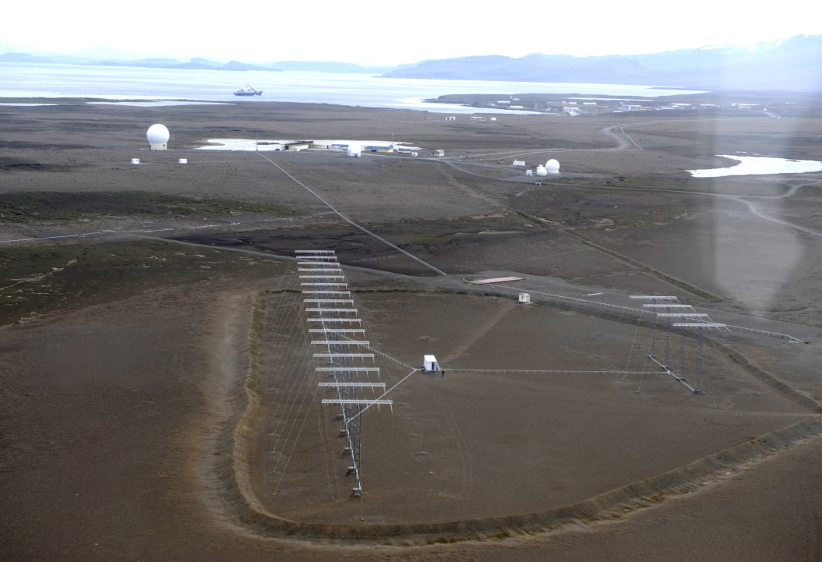
Status of the Kerguelen SuperDARN radar
Marchaudon, C. Hanuise, S. Chevrier, P. Fergeau, X. Vallières, G. Chalumeau
LPC2E, UMR 6115, CNRS / Université d’Orléans / OSUC, Orléans

Slide 28
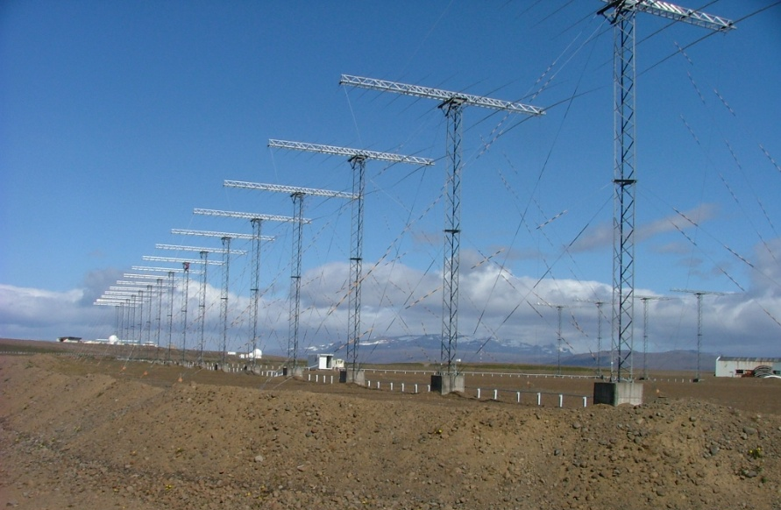
Status of the Kerguelen radar
- Installation in 1999/2000 by France and Italy
- Operations by LPC2E (France) with help of IPEV
Last maintenance during Southern Summer 2009/2010 (S. Chevrier and G. Chalumeau)
-> Operational
* Summary of 2010-2011 activity
Electronics
After the last maintenance, all 16 TX were operating
However due to TX’s oldness, already 2 of them have stopped working, and another one starts failing
Solution :
2 old TX have been repaired, and 2 new TX have been built by the Leicester University team
all 4 should be sent to Kerguelen as soon as possible
Problem with data transfer
After the last maintenance and the computers replacement, data files are now too large to be sent by satellite communication.
Solution :
all fitacf files and rawacf files for the 02:00-10:00 UT period (cusp) are sent by satellite communication
all rawacf files are copied on hard drives and shipped back 3-4 times per year
Notes:
3-4

Slide 29
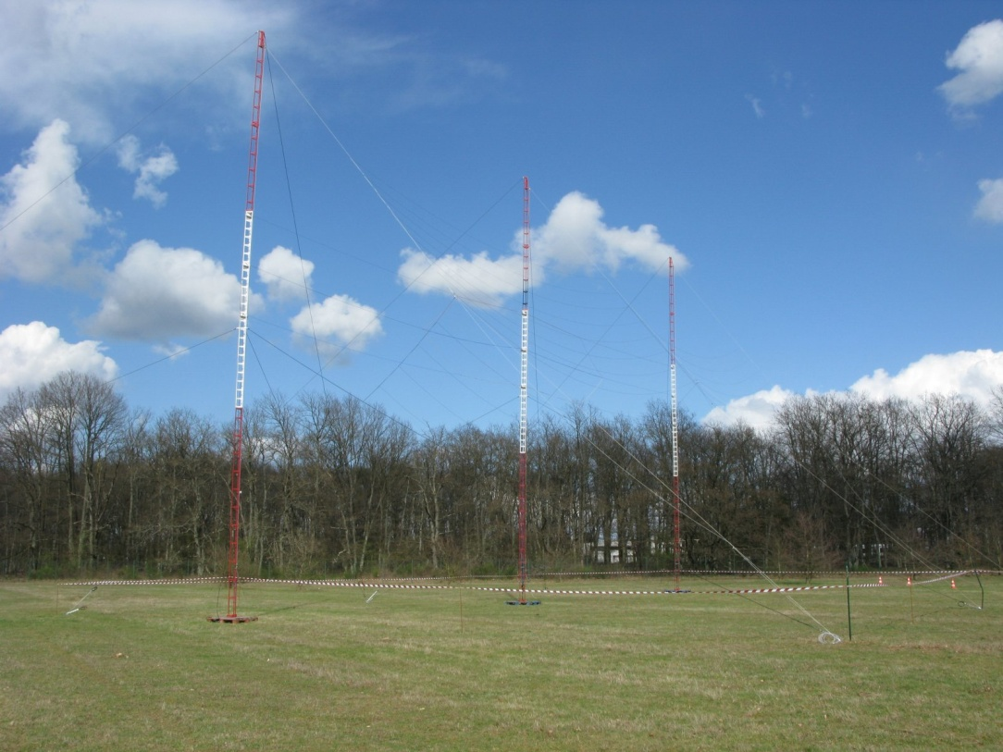
French participation to the Dôme C radars
- Installation of the 1st radar by Italy and France planned in 2012/2013
Operations by IFSI (Italy) with help of PNRA
French side:
- Assembly plan of the mechanical part of the radar antennas: ready
Testing the assembly of 3 antennas at LPC2E
Conditioning of the baluns and resistor boxes for the 2 radars
Ordering the computing system for the 2 radars at Saskatchewan University
Dôme C mission end of 2011:
Stéphane Chevrier and Frédéric Savoie will spend 2 weeks at Dôme C to verify the radar equipment, already on-site since 2007

Slide 30

Status of the Stokkseyri SuperDARN radar
Marchaudon, C. Hanuise, S. Chevrier, P. Fergeau, X. Vallières, G. Chalumeau
LPC2E, UMR 6115, CNRS / Université d’Orléans / OSUC, Orléans
and
Mark Lester
University of Leicester

Slide 31
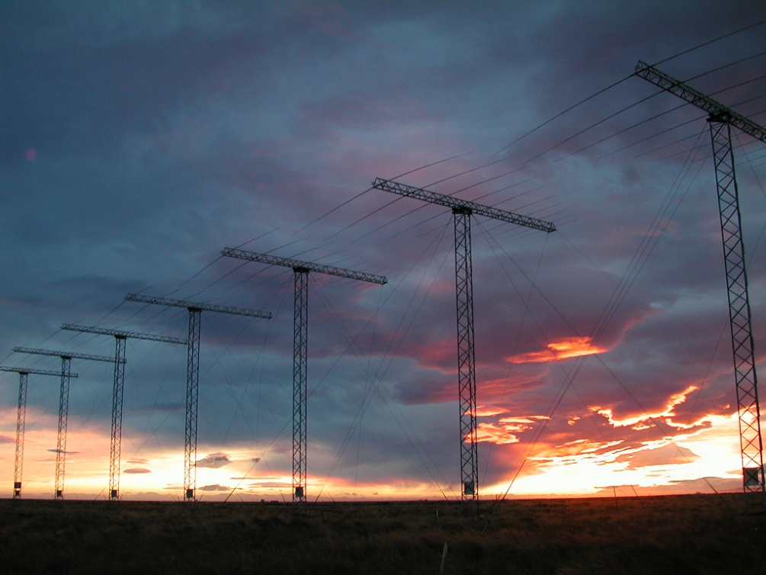
Stokkseyri Status
Stokkseyri radar electronics were returned to Leicester in November 2009 and refurbished during the following 12 months
Electronics were returned to Stokkseyri in November 2010 and worked well
In April 2011 a fault developed resulting in power loss at the site
Following discussions between Julian Thornhill and Patrice Fergeau a solution has been identified which will be put into place in the near future
Aurelie was also able to persuade the French funding council to provide operations funds for two more years starting in April 2011

Slide 32
Wallops Status
E. R. Talaat
The Johns Hopkins University
Applied Physics Laboratory

Slide 33
Wallops Radar Status
Radar operational
Radar went down on Oct 12 due to probable lightning strike that killed both the timing and QNX computers. We eventually had to wholly replace the computers and repair the digital I/O card. After several failed and/or partial resurrections (and holiday breaks), we were able to restore full functionality Feb 18.
Maintenance and repair for main array and interferometer array performed last year.

Slide 34
Status and Updates of
JHU/APL Data Facility
Through the efforts of Robin Barnes & Mathew Potter (JHU/APL):
The SuperDARN website (currently received over 3,200,000 hits per month from over 1800 unique IP addresses. The site has 1778 registered users and has served over 70,000 plots in the last year.
The data processing system has incorporated the new MSI radars and processes over 6.8GB per data a day. The inventory pages have been updated and improved
New web pages plot the radar fields of view and show the radar operating modes for any time period
The Convection Map summary plots have been upgraded to allow for dynamic plotting of the convection maps
New summary movies of daily convection are produced including the “particle flow” movies
The data analysis software includes new versions of the IGRF libraries and the GeoPack coordinate conversion libraries.
New IDL Dynamic Linked Modules replace the old CALL_EXTERNAL interface and provide direct access to the much higher speed C libraries with minimal configuration

Slide 35
Canadian SuperDARN PI report
George Sofko
and
Jean-Pierre St-Maurice

Slide 36
Main points
Radar updates
  General status of Canadian radars
  Third PolarDARN radar at Clyde River, Baffin Island
  DDS implementation
Changes in personnel

Slide 37
Radar status
The Canadian radars are currently at Saskatoon, Prince George, Rankin Inlet and Inuvik.
All radars are operating to near perfection. No major problem to report.

Slide 38
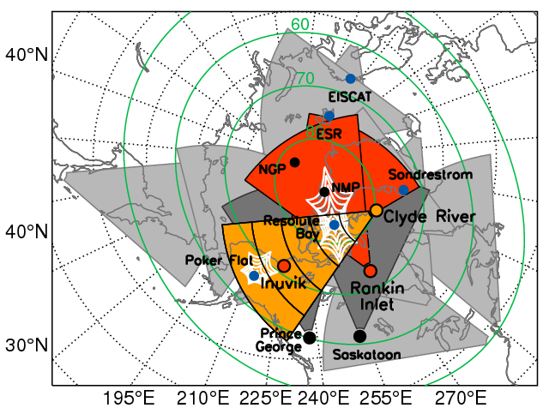
Radar update: Clyde River

Slide 39
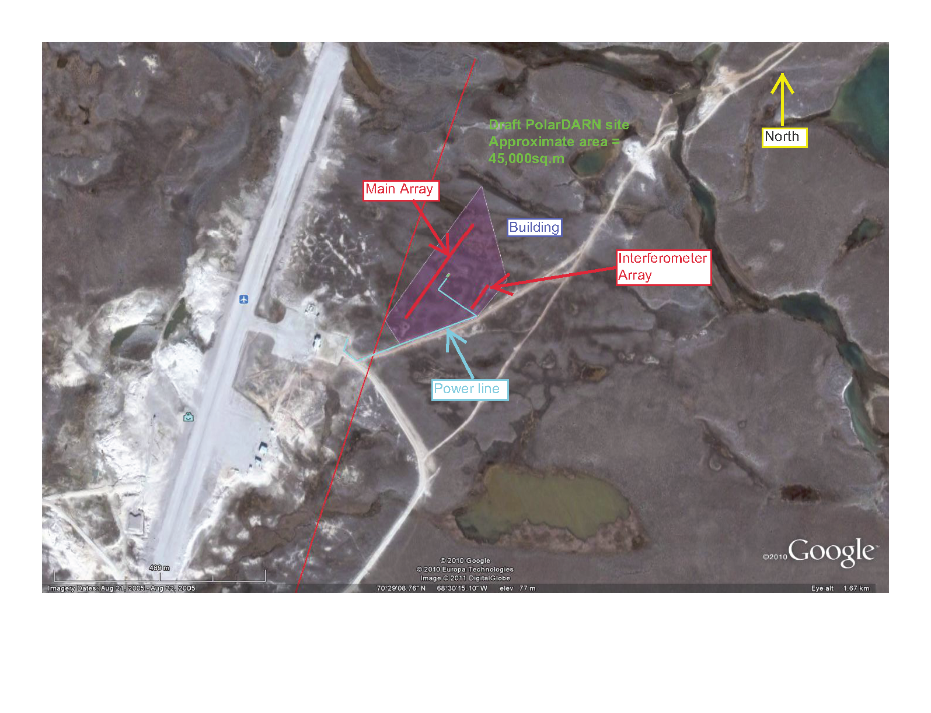

Slide 40
Points to note about Clyde River
Funding is in place and shipment of antennas and much of the hardware to Clyde will be taking place by the end of July. “First light” expected Fall 2012.
The distance and bore sight will be such as to optimize the returns over RISR-C incoherent scatter radar. Overlap with Poker Flat will also happen at times
  McWilliams and St-Maurice also involved heavily with RISR-C
Overlap with the other two PolarDARN radars and Saskatoon.

Slide 41
Radar update: DDS
The DDS is now fully implemented and functional at Inuvik
  Dieter has a poster for the details
  Installation of DDS at Rankin Inlet and Prince George later this year
  Saskatoon this year also, possibly
  Clyde River will also have a DDS when coming online in 2012

Slide 42
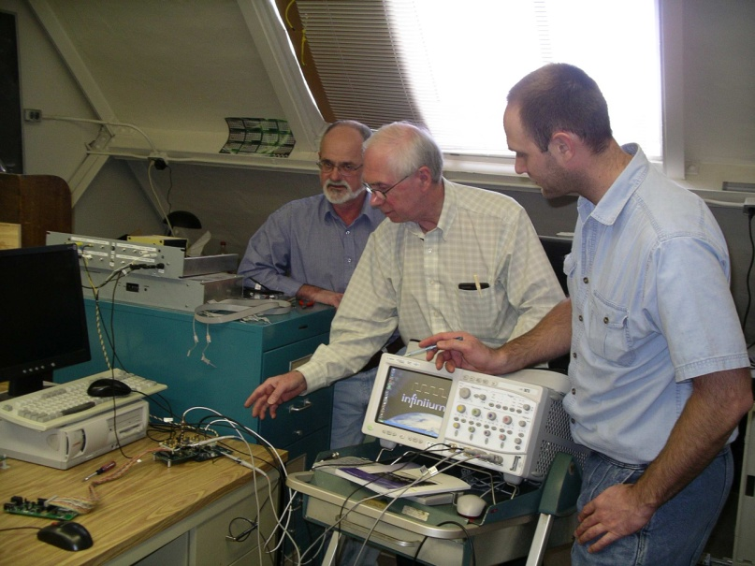
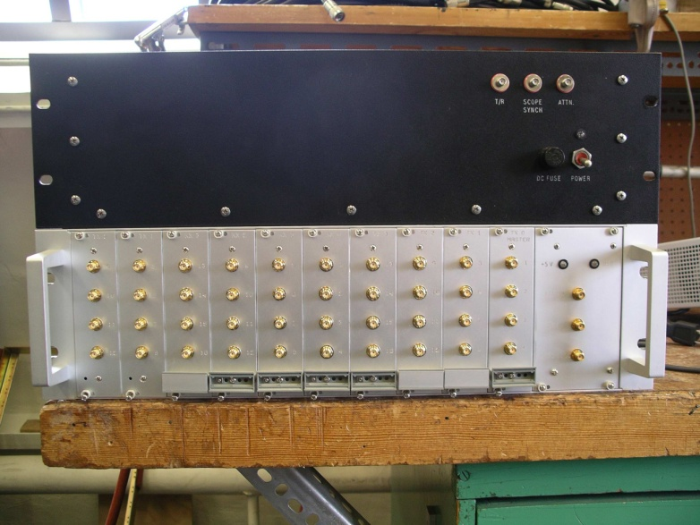
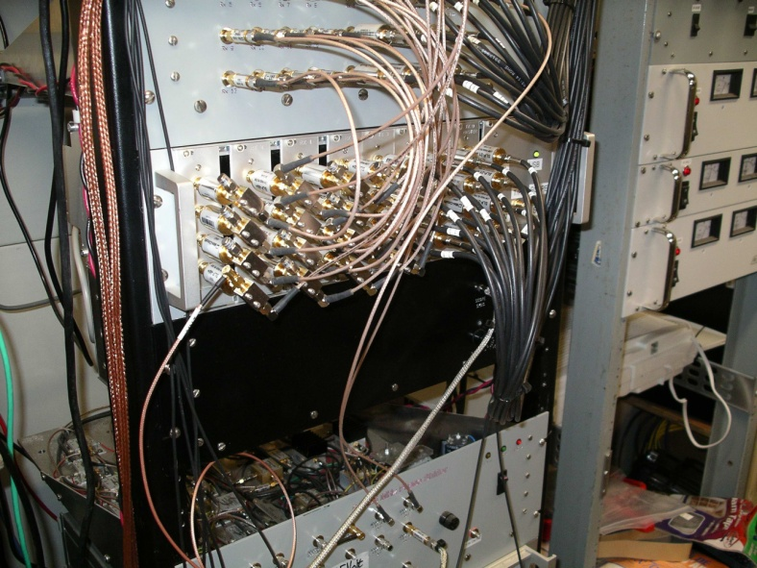
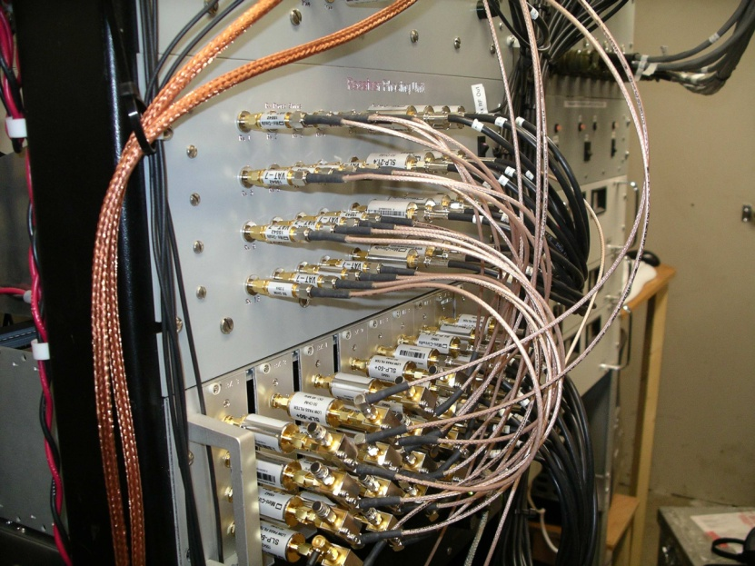
DDS prototype under scrutiny
DDS rack
DDS , as installed in Inuvik

Slide 43
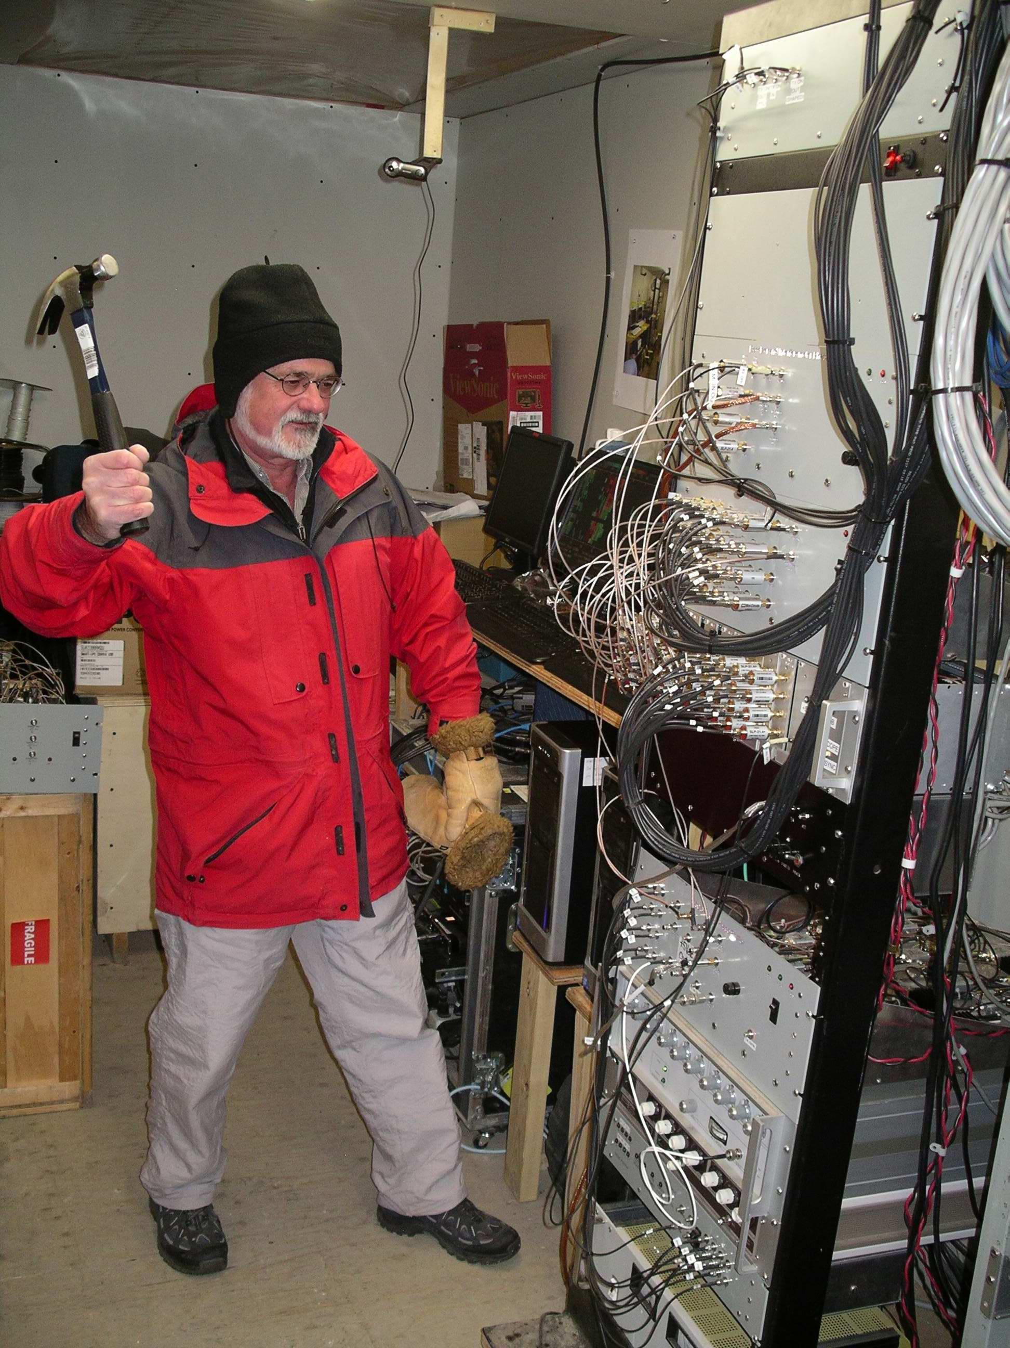
Rotation of personnel
Data Copy Distribution Facility
  Dieter is retiring from that responsibility and is now half-time (shown in the next pic doing the final phase calibration of the DDS)
  Heartfelt thanks to Dieter
    Spontaneous applause is suggested here
  Chad Bryant taking over for Dieter.

Slide 44
The last 12 months – The Network
Have been very successful for the network as well as for individuals – currently have 18 radars in NH and 9 in SH
Russian colleagues, lead by Volodya Kurkin, have been awarded funding for two radars to be deployed in Siberia which will be built at Leicester for deployment in September and December 2011
New radars are being built and will be deployed in 2011 in Australia and Canada
Proposal for new radar at South Pole has been funded
Continued development of the MSI radars with the deployment of the two radars in Christmas Valley in 2010
Radars at Zhongshan, McMurdo and Falkland Islands have had one full year of operation
Stokkseyri electronics have been refurbished and redeployed

Slide 45


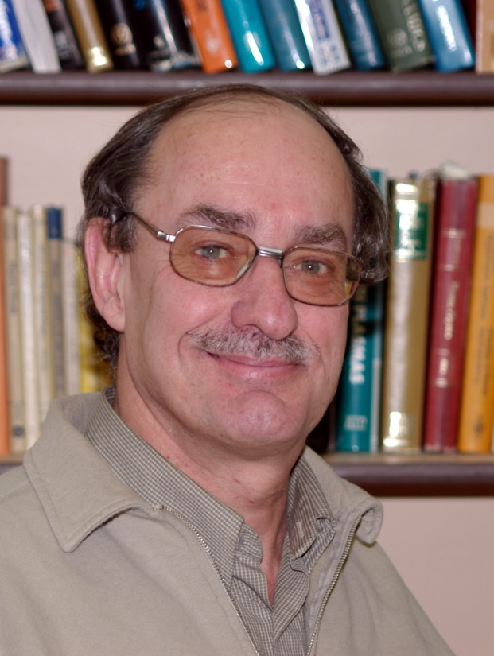
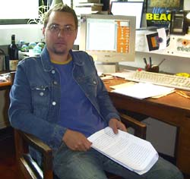

The last 12 months – Individuals
Steve Milan has been promoted to Professor
Jean-Pierre St. Maurice has been appointed to the COSPAR Bureau
Former CUTLASS PI Tudor Jones was aawarded an MBE in the New Years Honours List
Jo Baker has been named the Steven O. Lane Junior Faculty Fellow of Electrical and Computer Engineering by the Virginia Tech Board of Visitors. The fellowship is presented to a junior faculty member for teaching and research excellence.
Kevin Sterne has been hired at VT as Radar Project Engineer following completion of his Master's degree.

Slide 46
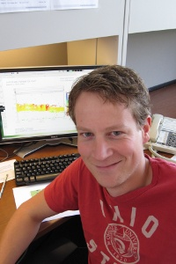
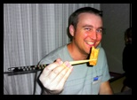

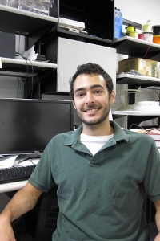
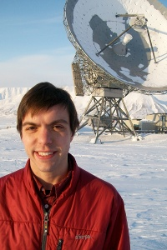
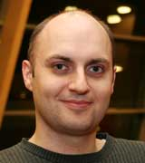
The last 12 months – Individuals
Kjellmar Oksavik has been appointed full Professor at University of Bergen and takes up his appointment on June 1 2011.
A. J. Riberio and Nathaniel Frissell have also completed their Master’s degrees
Lasse Clausen has been awarded the Best Thesis Prize by the College of Science and Engineering at University of Leicester in 2010
Todd Parris has moved to the Air Force Geophysics Laboratory at Albuquerque – he is still writing his thesis though......
Adrian Grocott has been awarded a JSPS Invitation Fellowship jointly with NIPR

Slide 47
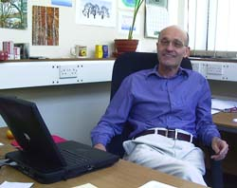
The last 12 months – Individuals
Stan Cowley has been elected as Fellow of the Royal Society
The citation identifies his ”pioneering research on solar wind-magnetosphere-ionosphere interactions” and “combining theoretical analysis with observations from the ground and space.”
Since his move to Leicester in 1996 Stan has been extremely supportive of the SuperDARN programme

Slide 48

Happy Birthday Ray!!

Slide 49
Summary
The last 12 months have been a successful year for SuperDARN
We look forward to another new year of radar construction and continued scientific excellence
Enjoy the meeting!

